Slide 1
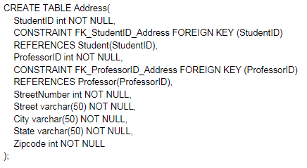
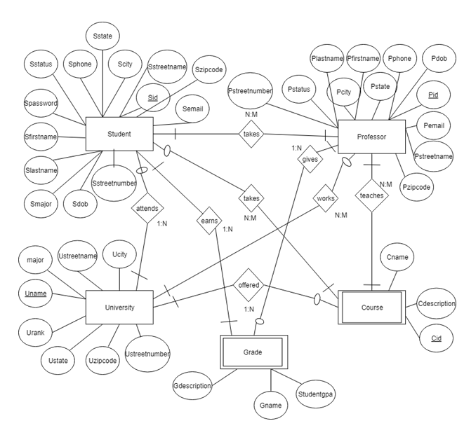

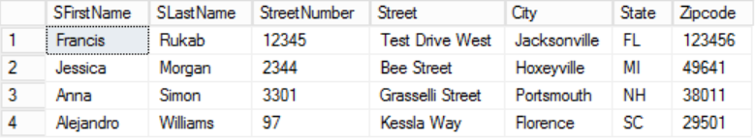
Relationships with the University
Angry Nerds - Information Processing: Organizational Perspective
Elizabeth Ruby, Ryan Rukab, Johlani Bryant, Michael Moser
Project Creation
Normalization
Database Creation
Our group wanted a way to keep track of student records such as the classes they are taking and what grade they have in that class. We decided to use a database because it allows for updation, deletion, and insertion of data. This means if we change an attribute in one table, it will be changed in all the other tables as well. In a school setting such as UNF, there are many Students, Professors and Courses that change between each semester. Below we show the ER Diagram that we used in order to design our tables. This is one of the first steps in making a database.
We began our normalization process by ensuring that our project was in the first normal form (1NF). To do this we had to prove that no row was exactly the same and by picking the candidate keys. The candidate keys we chose were: StudentID, ProfessorID, CourseID, and Zipcode. This is because all attributes rely on these specific attributes. Once we do this, we are able to move into the process of second normal form (2NF). This is achieved by ensuring all the functional dependencies are dealt with.
FD 1 - (StudentID)→(SFirstName, SLastName, SEmail, SPhone, StudentGPA, Smajor, CourseID)
FD 2 - (ProfessorID)→(PFirstName, PLastName, PEmail, PPhone, CourseID)
FD 3 - (CourseID)→(Cname)
FD 4 - (StudentID, CourseID)→(Gname)
FD 5 - (StudentID, ProfessorID) → (City, Street, StreetNumber, State, Zipcode)
The last step is making sure the tables are in third normal form (3NF). Third normal form is achieved by removing any partial dependencies.
FD 1 - (StudentID)→(SFirstName, SLastName, SEmail, SPhone, StudentGPA, Smajor)
FD 2 - (ProfessorID)→(PFirstName, PLastName, PEmail, PPhone)
FD 3 - (CourseID)→(Cname, StudentID, ProfessorID)
FD 4 - (StudentID, CourseID)→(Gname)
FD 5 - (StudentID, ProfessorID) → (City, Street, StreetNumber, State, Zipcode)
To create the tables, we had to follow the MySQL commands. An example of these commands is shown in the illustration below. First, the CREATE TABLE command was used in order to actually make the table. The CONSTRAINT command creates a new column within the table, but it also shows that it is a reference to another table. This is why it is coupled with the REFERENCES command. The command NOT NULL is used to simply state that the values cannot be empty.
In the illustration below, you can see that we combined attributes from the Student table (SFirstName and SLastName) as well as the attributes from the Address table. This is done with the JOIN command.
Notes:
Template ID: h118_4x6

